Slide 1
HS CAMPAIGNE IN CROATIA
Zlatica Jukić, specialist of dermatovenerology
Melita Vukšić Polić, specialist of dermatovenerology
Clinical Hospital Osijek
CROATIA

Slide 2
The role of campaigns of awareness
Public awareness campaigns are created to educate the public about specific issues.
- stimulate dialogue
- alter social consciousness
- encourage people to change their thougts and actions
A lot of benefits:
- increase interactions with others (patients adherence, medical advices thrue the media…)
- increase accessibiliy and widening access
- peers/social/emotional support
- public health surveillance

Slide 3
- social media hold potential for complimentary informations, on-line could promote healthy life style, disease risk and potential interventions, can measure the public reaction
- potential to influence healthy policy and needs to established social media guidelines in writing and advertising
- help patients, medical stuff, researchers to create evidence based programes
IT IS VERY COMPREHENSIVE ,WORTH AND RESPONSIBLE TEAM WORK!!!

Slide 4
WHEN WE USE AWARENESS CAPAIGNES?
- when wide exposure is desired
- when the timeframe is urgent
- when public discussion is likely to facilitate the educational process
- when awareness is a main goal
- when “media” authorities are “on side”
- when accompanying back-up can be provided
- when long-term follow-up is possible
- when a generous budget exist
- when the behavioural goal is simple
- when the agenda includes public relations

Slide 5
KARL MARX (1818-1883) famous phylosopher and father of modern comunism had HS

Slide 7
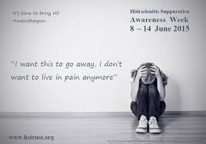

Slide 8
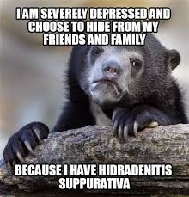

Slide 9
AWARENESS CAMPAIGN ON HYDRADENITIS SUPPURATIVA
This awareness campaign started in October 2012. Nobody can slip out of his own skin. The aim was to increase awareness of the daily challenges faced people suffering from psoriasis. They are not fully accepted by the society despite the fact that they are equal!

Slide 10
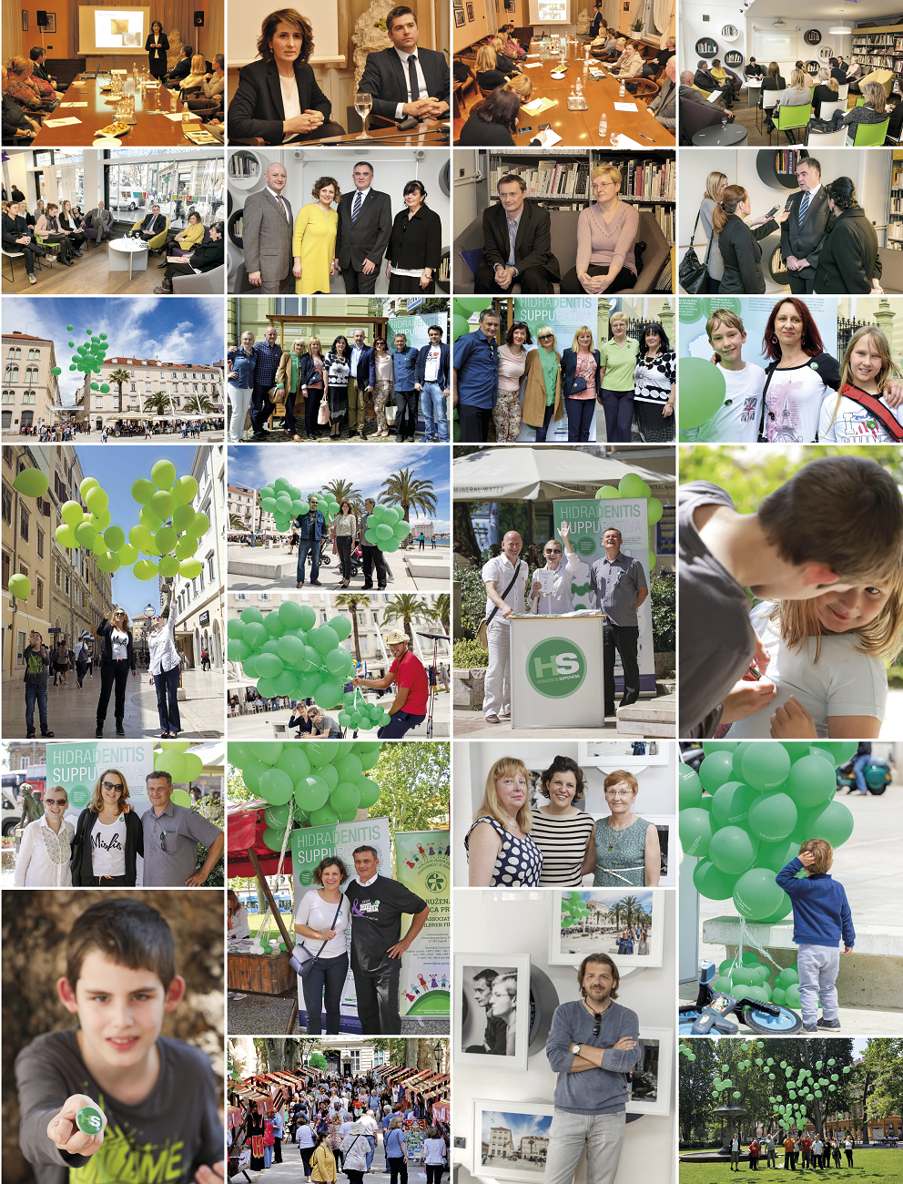
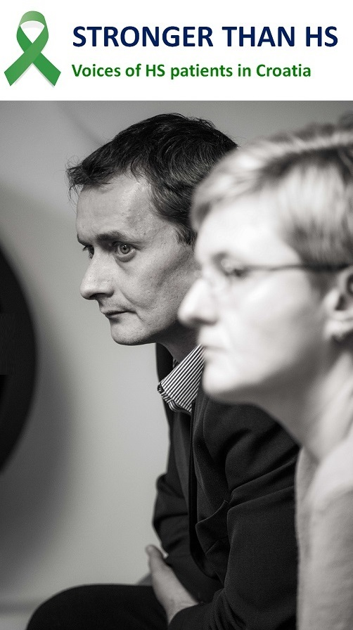

Slide 11
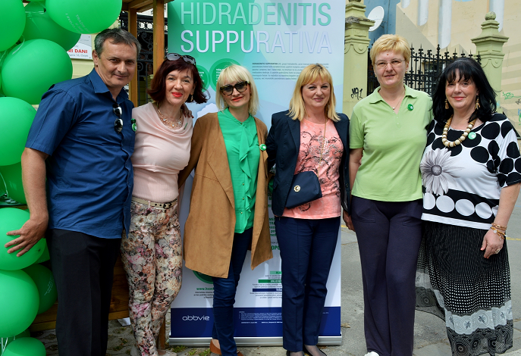
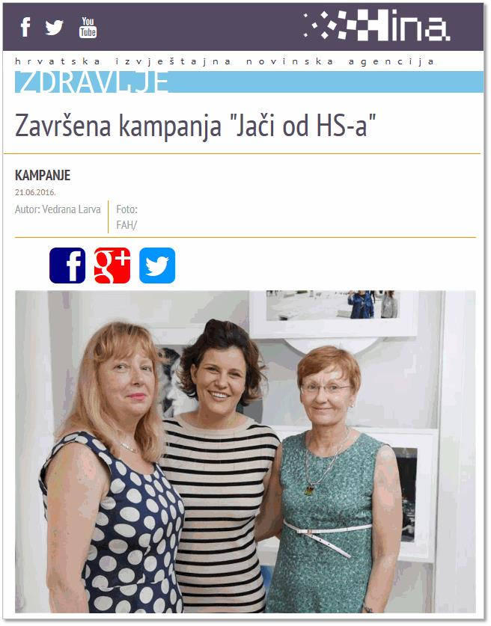
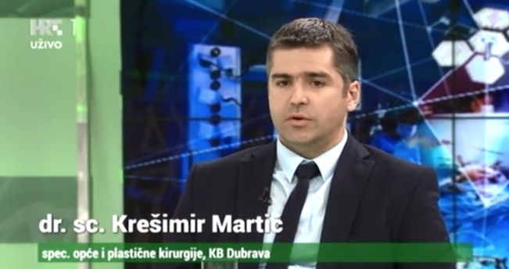
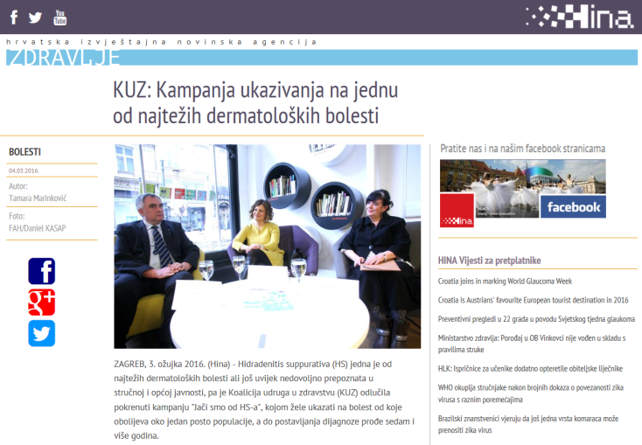
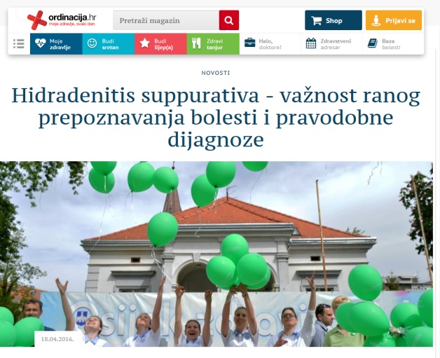
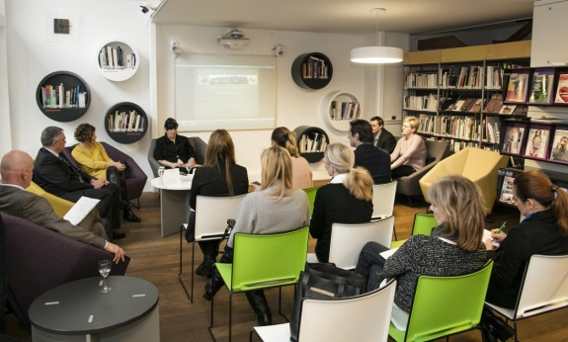
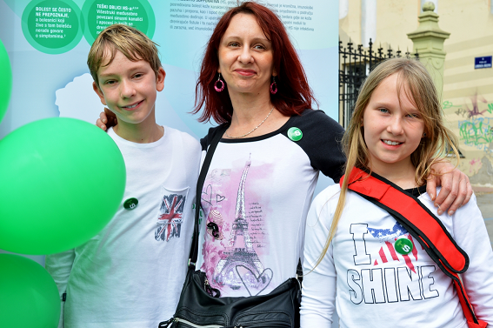
Nacionalna kampanja podizanja svijesti o HS-u

Slide 12
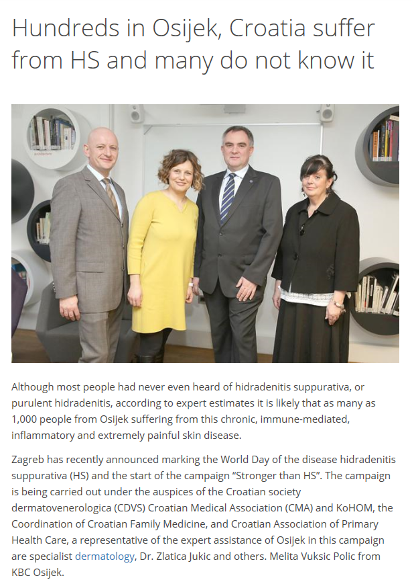
www.hidradenitissuppurativaawareness.org
Notes:
http://hidradenitissuppurativaawareness.org/hundreds-in-osijek-croatia-suffer-from-hs-and-many-do-not-know-it/

Slide 13
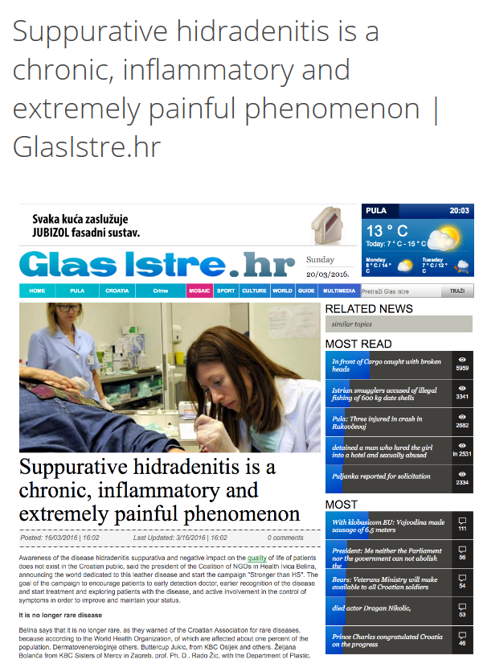
www.hidradenitissuppurativaawareness.org
Notes:
http://hidradenitissuppurativaawareness.org/suppurative-hidradenitis-is-a-chronic-inflammatory-and-extremely-painful-phenomenon-glasistre-hr/

Slide 14
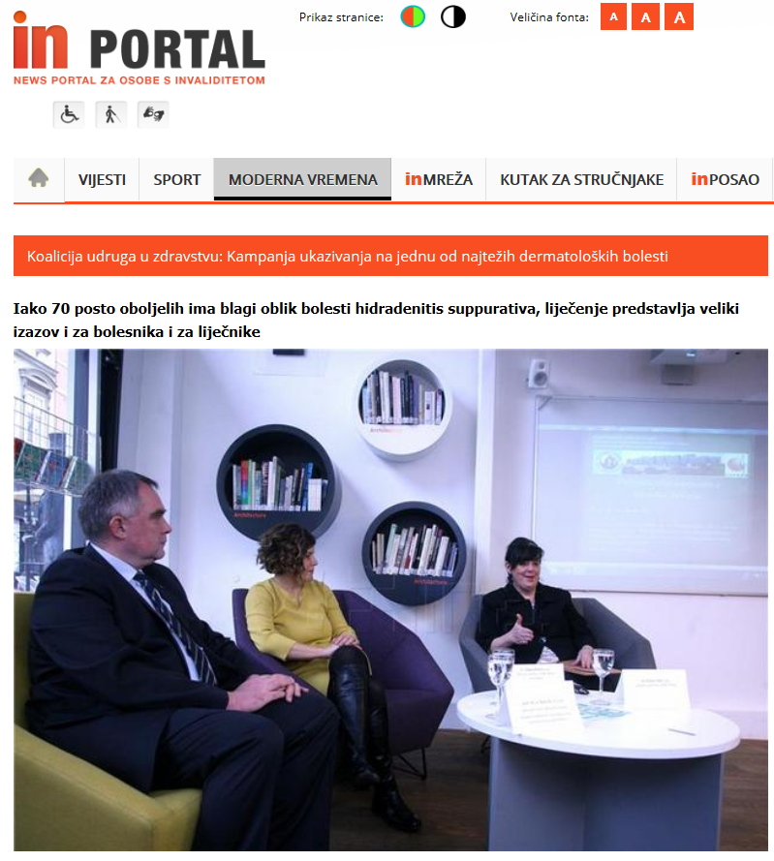
Notes:
http://www.in-portal.hr/pretraga/10295/koalicija-udruga-u-zdravstvu-kampanja-ukazivanja-na-jednu-od-najtezih-dermatoloskih-bolesti
14

Slide 15
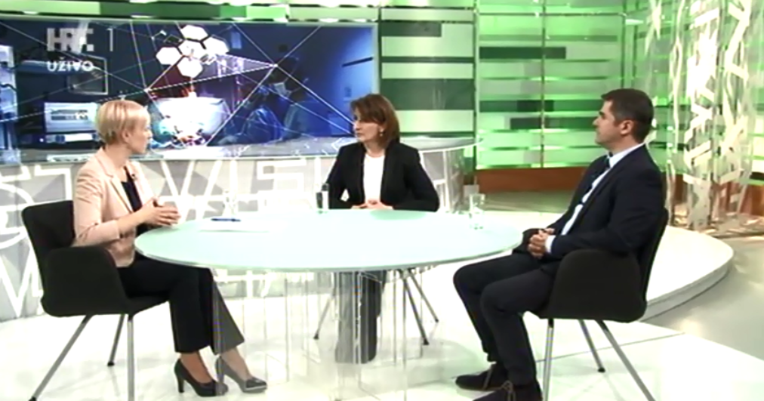
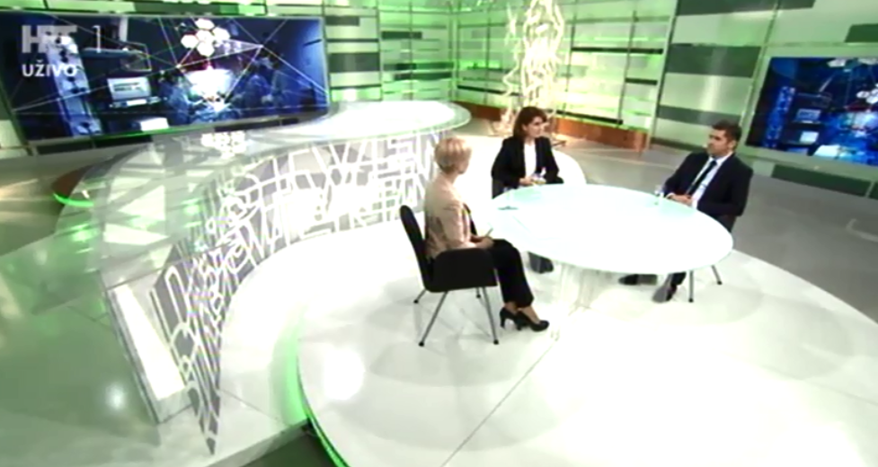
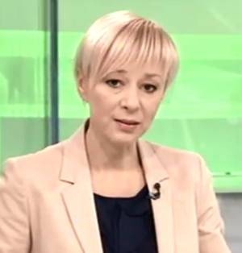
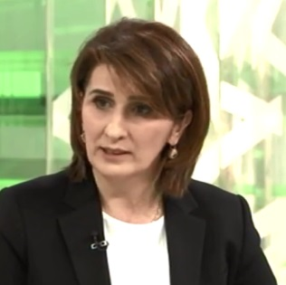
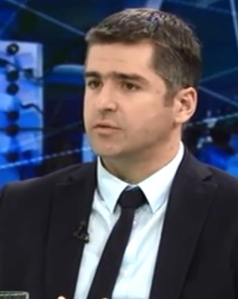
Prof. Zrinka Bukvić Mokos
dermatovenerolog, KBC Zagreb
Dr. Krešimir Martić
plastični kirurg, KB Dubrava
Notes:
http://www.hrt.hr/enz/drustvena-mreza/
15

Slide 16
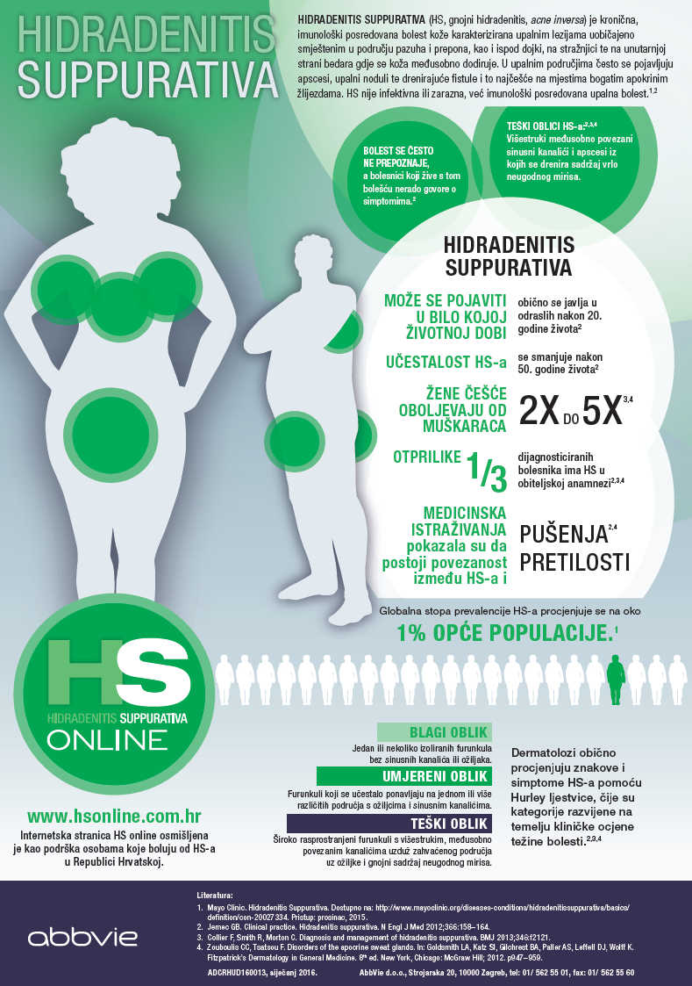
MEDIA ACTIVITIES!!!
HS posteri, letci i oglasi u medicinskim časopisima
HS posteri za čekaonice – 50 komada
HS letci za čekaonice – 3.000 komada
HS oglasi:
01/2016. Jutarnji list ''Doktor u kući''
02/ 2016. Liječnički vjesnik
02/2016. Medix
03/2016. Acta Dermatovenerologica Croatica

Slide 17
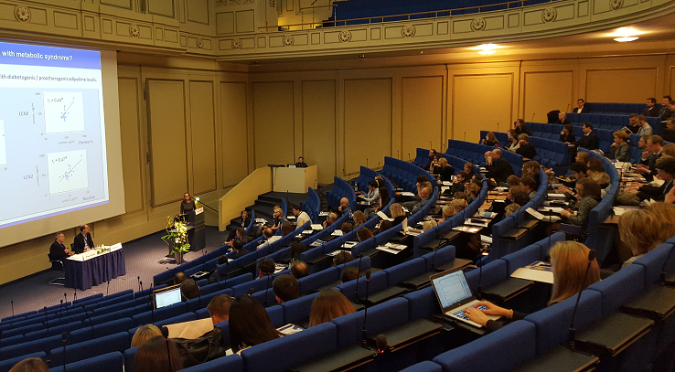
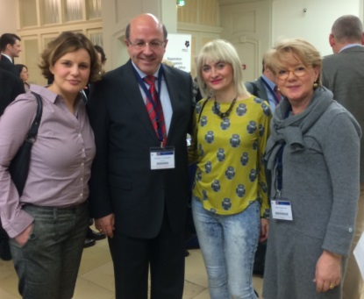
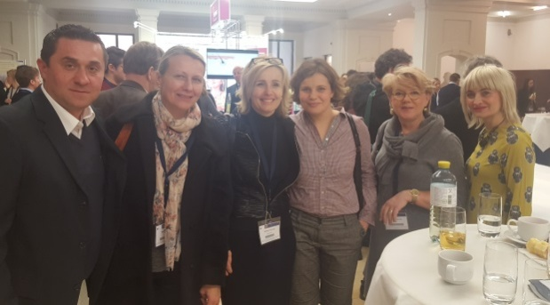
CROATIAN DERMATOLOGICAL-SURGERY GUIDELINES FOR TREATMENT OF HS
Prof. Ines Brajac, KBC Rijeka
Prof. Zrinka Bukvić Mokos, KBC Zagreb
Prof. Neira Puizina Ivić, KBC Split
Mr. sc. Melita Vukšić Polić, KBC Osijek
Dr. Željana Bolanča, KBC Sestre milosrdnice, Zagreb

Slide 18
NATIONAL CAMPAIGNE STRONGER THAN HS - Nacionalna kampanja podizanja svijesti o HS-u

Slide 19
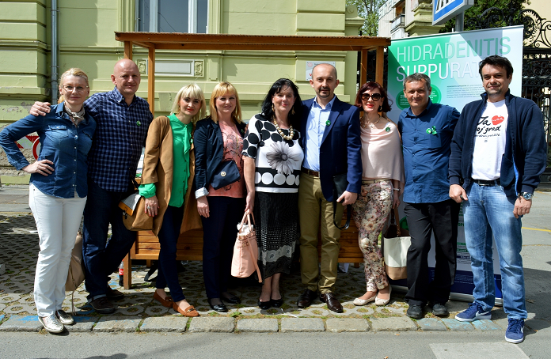
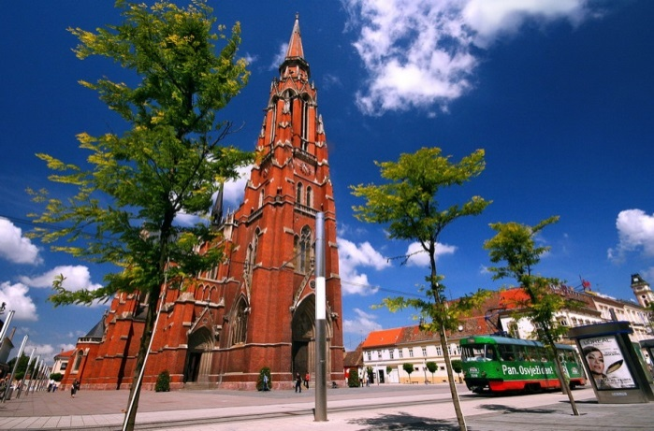
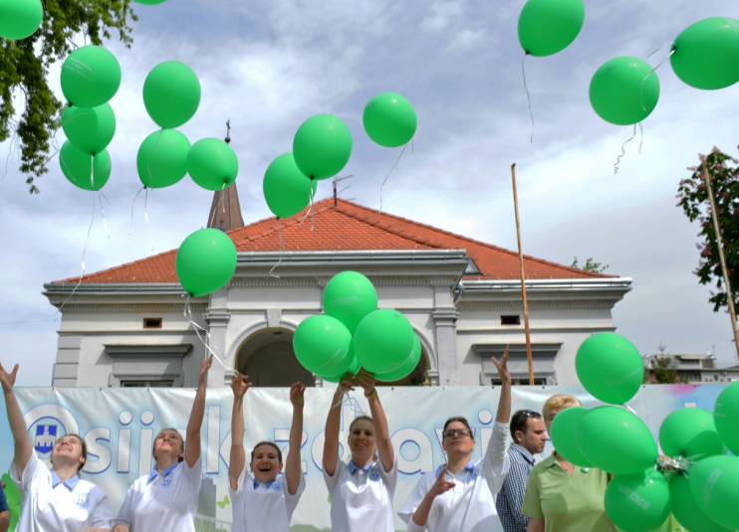
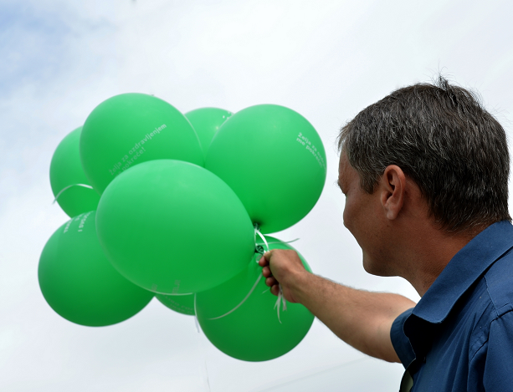
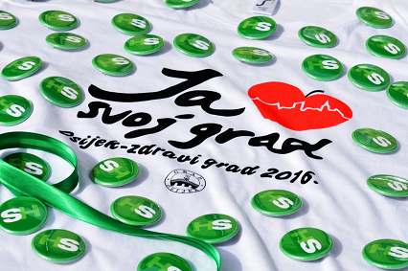
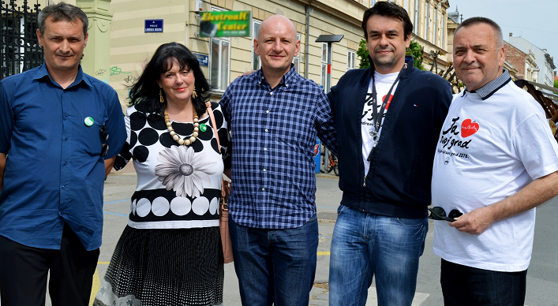
Osijek, 17. travnja 2016.
19

Slide 20
INTERDISCIPLINARY APPROACH! STRONGER THAN HS!!!!
Interdisciplinarni pristup – ključ uspjeha za liječenje HS-a
Dermatolozi
Plastični kirurzi
Ginekolozi
Gastroenterolozi
Obiteljska
medicina
Internisti
Psiholozi
Psihijatri
Med. sestre
Nutricionisti...
Reumatolozi

Slide 21
WHERE WE ARE?
A lot of work has been done!
Our patients are connected due to influence of media, themselves and us as dermatologists
General medicine practitioners are better informed
Other specialists are included
We have Guidelines for both Psoriasis vulgaris and Hydradenitis suppurativa
We have comprehensive therapy for both illness
We have precious materials for scientific researches

