Slide 1
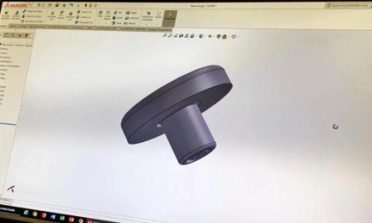
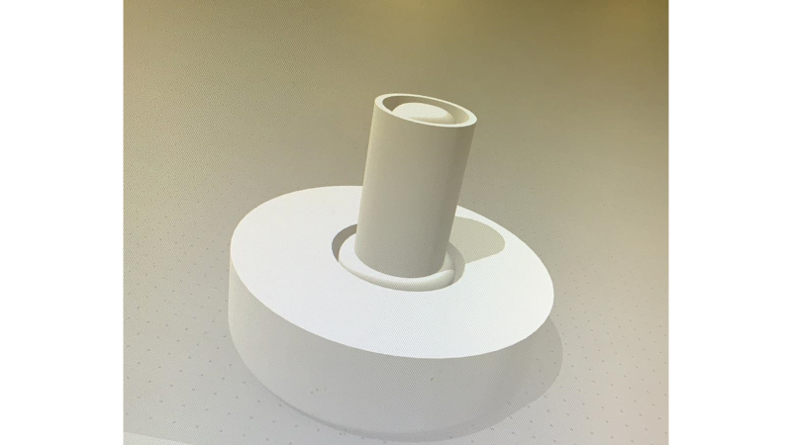
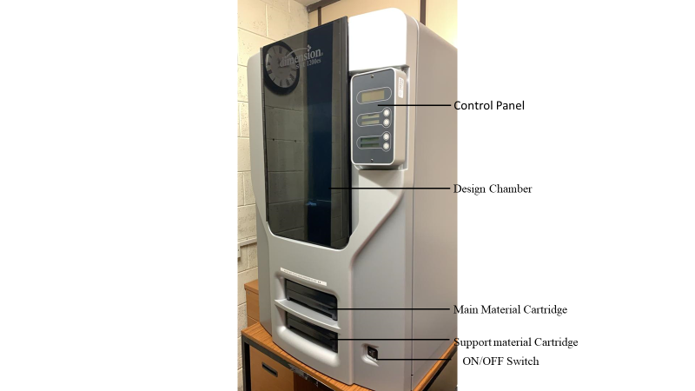
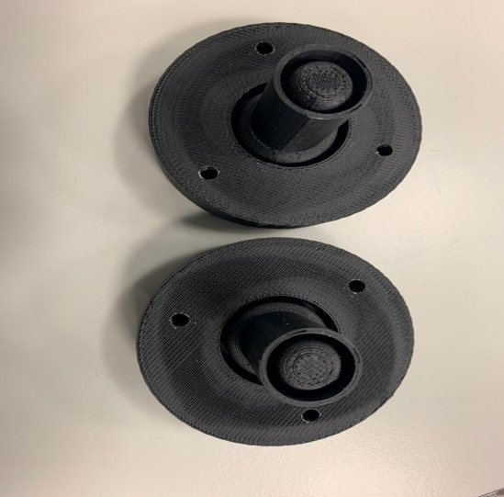
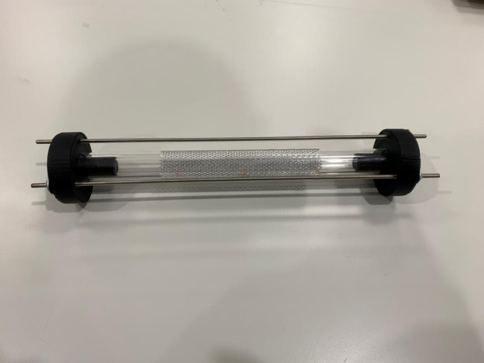
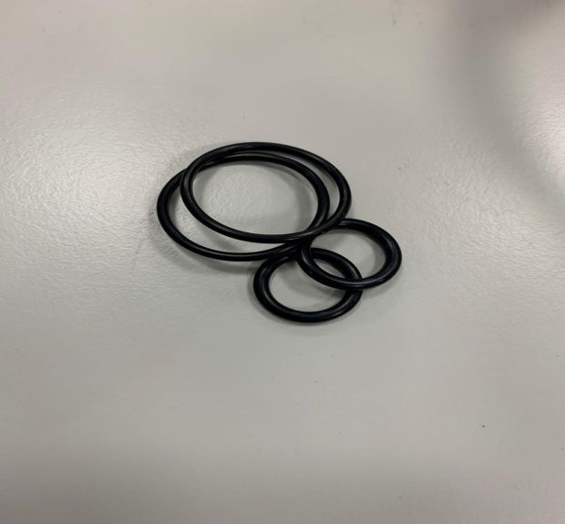
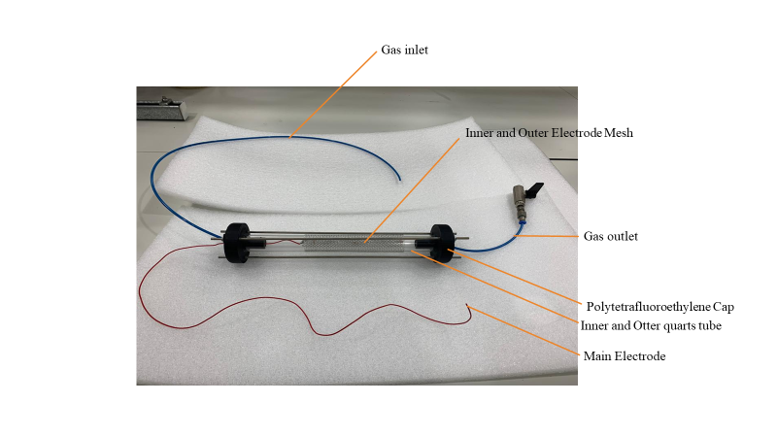
CONSTRUCTION/ASSEMBLING OF A NOVEL DBD PLASMA REACTOR CAP USING POLYTETRAFLUOROETHYLENE (PTFE)
I. Y. Bakoji¹, M. Babaie, A Nourian
School of Computing, Science & Engineering, University of Salford, Manchester M5 4WT, UK
3D-printing technology implementation has opened new frontiers in engineering, material science, chemistry, and medicine. A plasma reactor is an invention and crucial device in the plasma field of engineering. This research aims to test and determine the feasibility of assembling a Dielectric barrier discharge plasma reactor (DBD) with new caps fabricated using Fused Deposition Modelling (FDM) using a 3D printer and to establish its appropriateness for use in the DBD reactor setup. The material properties of Polytetrafluoroethylene (PTFE) is explored to establish appropriateness for use in the reactor setup or yet as a solid material in the plasma reactions. Overall, this process give emphasis to the advances and prospective utilisation of a combination of CAD and 3D technology in the successful assembly of a plasma dielectric barrier discharge (DBD) reactor. In this study, a new approach for the design and fabrication of a Dielectric discharge reactor (DBD) with novel caps fabricated using Fused Deposition Modelling (FDM) is presented by using 3D printing technology.
INTRODUCTION
OBJECTIVES
DBDs) popularly known as Dielectric Barrier is a generated plasma configuration within defined insulation called the dielectric, situated between electrode responsible for self pulsing operation [1]. DBDs settings and principles characterised by the presence of insulating material in the discharge path. Typically (DBD) materials such as glass, quartz, ceramic, enamel, mica, plastic, silicon rubber or Teflon are used [2]. Dielectric Barrier Discharge (DBD) reactor produces cold plasma comprising of electrons, ions, ultraviolet photons, radical excited and ground-state molecules near room temperature and pressure.
Polytetrafluoroethylene (PTFE) is a synthetic fluoropolymer of tetrafluoroethylene with unique properties [11] such as; 1) 600 K (327 °C) melting point, exhibits high strength and robustness at low temperatures (5 K or 268.15 °C), with good plasticity at temperatures above 194 K (−79 °C). At temperatures above 650–700 °C, depolymerisation occurs. These material properties make PTFE appropriate for use in plasma reactor setups and as a functional material in the plasma configuration. PTFE is hydrophobic [12], Has superior chemical resistance (gasoline, solvents, water and other polar media), exceptional thermal properties [13], and dielectric properties [2].
Conversely, the use of 3D printing in the plasma engineering field still has not been fully realized. This research project argues that because rapid prototyping of a 3D printer is ideal for the manufacture of a multi-geometry non-thermal plasma re(actor, it can not be easily produced using traditional methods. The first invention of a non-thermal plasma reactor powered at atmospheric pressure could be traced all the way back from a historical point of view to the ozonizer developed by Siemens in the 1850s [23]. Various types of plasma reactors have been built and tested to date [24]–[26]. The plasma reactor consists primarily of electrodes (metals) and the supporting components (insulators). In general, the insulating pieces are made of glass, ceramics or plastics. Therefore the design and manufacturing parameters for such a reactor has limitations [19].
METHODS
The polytetrafluoroethylene (PTFE) Cap was designed using the solid works software (Figure 2). During this creation process, a circle with dimension to 60mm was drawn on a plane and then protruded to 20 mm. Thereafter, two circles with diameter 28.2mm and 24.8mm were drawn, with widths of 3.4 mm to allow the larger quartz tube sit properly in the cap. Another circle of 30mm protrusion is drawn with two (2) circles of diameters 16.2mm and 12.8mm extruded for a depth of 15mm and width 3.4mm to also allow the inner quartz tube fix into the caps.
Figure 3 presents the STL Electronic Profile for polytetrafluoroethylene (PTFE) caps designed using solid works software. The CAD image shows the bottom circle with a dimension of 60mm, with protrusion of 20 mm. The two lower circles have diameters of 28.2mm and 24.8mm, with widths of 3.4 mm. The top circle has a 30mm protrusion with two (2) circles of diameters 16.2mm and 12.8mm extruded for a depth of 15mm and width 3.4mm to also allow the inner quartz tube fix into the caps.
After designing the caps via solid-works, the frame is prepared for printing via the Fused Deposition Modelling (FDM) 3D printer dimension SST 1200ES shown in Figure 4. The main and supporting design material is inserted in their respective cartridges, the print tray is the loaded into the design chamber and subsequently, the printer is switched on. The electronic profile was then loaded into the control software of the 3D printer. Once this is loaded, the size and orientation are configured and added to a print job for printing.
Figure 5 shows the caps after printing and separation from the supporting material parts and Figure 6 present the PTFE O-strings and cap fitted to a quartz tube glass. 3D-printed caps exhibiting a circular geometry with a void in the centre were designed by the CAD (Computer-aided design) software “solid works”. The caps were then fitted to a quartz glass tube to keep the reactor airtight.
Figure 2: Conceptual Cap Design using Solid Works Software
Figure 3: STL Electronic Profile for Polytetrafluoroethylene Caps
Figure 4: 3D printer dimension SST 1200ES
Figure 5: 3D Printed Polytetrafluoroethylene Caps
Figure 7: Caps with O-string rubber fixed on Quartz tube
RESULTS
CONCLUSION
An innovative Double barrier dielectric reactor (DBD) (Figure 9) was designed and assembled in the university of Salford laboratory for this research as outlined in the Phase of experimental methodology. The coaxial type DBD reactor has double dielectric barriers that reduce or prevent any contribution from the metal electrodes on the performance of the reaction. The reactor was assembled by sourcing from Hilgenberg in Germany, three (3) sets of quartz glass tubes of length 250-300, 350-400, 450-500 mm with internal diameters and external diameters of 13, 16 mm and 25, 28 mm respectively for each pair. The quartz glass tubes are then coupled in pairs (Figure 8) Polytetrafluoroethylene Caps were designed with Solid-Works Educational Edition software and fabricated using a Fused Deposition Modelling (FDM) 3D Printer. The PTFE caps with o-string rubber are fixed at the ends of the quartz glass tubes as shown in Figure 7 above.
We presented a Dielectric Barrier Discharge reactor (DBD) assembled with novel caps fabricated using Fused Deposition Modelling (FDM) in a 3D printer.
Material properties of Polytetrafluoroethylene (PTFE) were explored to establish its appropriateness for use in the reactor setup or yet as a practical material in the plasma reactions. The process verified that computer-aided design (CAD) can be used successfully to design DBD reactor components; whilst 3D printing by means of FDM using polytetrafluoroethylene can convert 3D models of CAD files into high-quality parts. Overall, these processes give emphasis to the advances and prospective utilisation of a combination of CAD and 3D technology in the assembly of a plasma dielectric barrier discharge (DBD) reactor.
Figure 9: Coaxial Dielectric Barrier (DBD) reactor
REFERENCES
[1]R. Brandenburg, “Corrigendum: Dielectric barrier discharges: progress on plasma sources and on the understanding of regimes and single filaments (Plasma Sources Science and Technology (2017) 26 (053001) DOI: 10.1088/1361-6595/aa6426),” Plasma Sources Sci. Technol., vol. 27, no. 7, 2018, doi: 10.1088/1361-6595/aaced9.
[2]C. Dichtl, P. Sippel, and S. Krohns, “Dielectric Properties of 3D Printed Polylactic Acid,” Adv. Mater. Sci. Eng., vol. 2017, 2017, doi: 10.1155/2017/6913835.
[3]S. Gadkari, X. Tu, and S. Gu, “Fluid model for a partially packed dielectric barrier discharge plasma reactor,” Phys. Plasmas, vol. 24, no. 9, 2017, doi: 10.1063/1.5000523.
[4]C. J. Liu, G. H. Xu, and T. Wang, “Non-thermal plasma approaches in CO2 utilization,” Fuel Process. Technol., vol. 58, no. 2, pp. 119–134, 1999, doi: 10.1016/S0378-3820(98)00091-5.
[5]H. H. Nguven and K. S. Kim, “CO2 reforming of CH4 by the combination of dielectric barrier discharge plasma and zeolite catalysts,” Tech. Proc. 2014 NSTI Nanotechnol. Conf. Expo, NSTI-Nanotech 2014, vol. 1, pp. 192–195, 2014.
[6]N. Jiang, A. Ji, and Z. Cao, “Atmospheric pressure plasma jet: Effect of electrode configuration, discharge behavior, and its formation mechanism,” J. Appl. Phys., 2009, doi: 10.1063/1.3159884.
[7]N. Y. Babaeva and M. J. Kushner, “Interaction of multiple atmospheric-pressure micro-plasma jets in small arrays: He/O2 into humid air,” Plasma Sources Sci. Technol., 2014, doi: 10.1088/0963-0252/23/1/015007.
[8]I. A. Shkurenkov, Y. A. Mankelevich, and T. V. Rakhimova, “Two-dimensional simulation of an atmospheric-pressure RF DBD in a H 2: O2 mixture: Discharge structures and plasma chemistry,” Plasma Sources Sci. Technol., 2013, doi: 10.1088/0963-0252/22/1/015021. Non-Equilibrium Air Plasmas at Atmospheric Pressure. 2004.
[9]U. Kogelschatz, “Physics and applications of dielectric-barrier discharges,” IEEE Int. Conf. Plasma Sci., 2000, doi: 10.1109/plasma.2000.854539.
[11]H. S. Salapare, F. Guittard, X. Noblin, E. Taffin de Givenchy, F. Celestini, and H. J. Ramos, “Stability of the hydrophilic and superhydrophobic properties of oxygen plasma-treated poly(tetrafluoroethylene) surfaces,” J. Colloid Interface Sci., 2013, doi: 10.1016/j.jcis.2012.12.072.
[12]L. Zhang, “Journal Draft,” vol. 149. pp. 962–975, 2018, doi: 10.1016/j.agrformet.2008.12.001.
[13]M. J. van der Burgt, J. Cantle, and V. K. Boutkan, “Carbon dioxide disposal from coal-based IGCC’s in depleted gas fields,” Energy Convers. Manag., vol. 33, no. 5–8, pp. 603–610, 1992, doi: 10.1016/0196-8904(92)90062-2.
[14]T. Jacobs, R. Morent, N. De Geyter, P. Dubruel, and C. Leys, “Plasma surface modification of biomedical polymers: Influence on cell-material interaction,” Plasma Chemistry and Plasma Processing. 2012, doi: 10.1007/s11090-012-9394-8.
[15]O. S. Carneiro, A. F. Silva, and R. Gomes, “Fused deposition modeling with polypropylene,” Mater. Des., 2015, doi: 10.1016/j.matdes.2015.06.053.
[16]S. H. Ahn, M. Montero, D. Odell, S. Roundy, and P. K. Wright, “Anisotropic material properties of fused deposition modeling ABS,” Rapid Prototyp. J., 2002, doi: 10.1108/13552540210441166.
[17]M. D. Symes et al., “Integrated 3D-printed reactionware for chemical synthesis and analysis,” Nat. Chem., 2012, doi: 10.1038/nchem.1313.
[18]C. Zhang, B. Wijnen, and J. M. Pearce, “Open-Source 3-D Platform for Low-Cost Scientific Instrument Ecosystem,” J. Lab. Autom., 2016, doi: 10.1177/2211068215624406.
[19]S. Kanazawa, K. Eto, W. Imagawa, S. Akamine, and R. Ichiki, “3D-Printed Atmospheric-Pressure Plasma Reactors,” Int. J. Plasma Environ. Sci. Technol., vol. 9, no. 2, pp. 103–106, 2015.
[20]S. C. Ligon, R. Liska, J. Stampfl, M. Gurr, and R. Mülhaupt, “Polymers for 3D Printing and Customized Additive Manufacturing,” Chem. Rev., vol. 117, no. 15, pp. 10212–10290, 2017, doi: 10.1021/acs.chemrev.7b00074.
[21]R. Gusmão, M. P. Browne, Z. Sofer, and M. Pumera, “The capacitance and electron transfer of 3D-printed graphene electrodes are dramatically influenced by the type of solvent used for pre-treatment,” Electrochem. commun., vol. 102, no. March, pp. 83–88, 2019, doi: 10.1016/j.elecom.2019.04.004.
[22]R. Brandenburg, “Dielectric barrier discharges: Progress on plasma sources and on the understanding of regimes and single filaments,” Plasma Sources Sci. Technol., vol. 26, no. 5, p. 53001, 2017, doi: 10.1088/1361-6595/aa6426.
[23]W. Siemens, “Ueber die elektrostatische Induction und die Verzögerung des Stroms in Flaschendrähten,” Ann. Phys., 1857, doi: 10.1002/andp.18571780905.
[24]Y. Awatsu, M. Kuroda, and Y. Shibuya, “A Ceramic-Based Ozonizer Using High-Frequency Discharge,” IEEE Trans. Ind. Appl., 1988, doi: 10.1109/28.2860.
[25]B. Eliasson and U. Kogelschatz, “Nonequilibrium Volume Plasma Chemical Processing,” IEEE Trans. Plasma Sci., 1991, doi: 10.1109/27.125031.

