Slide 1
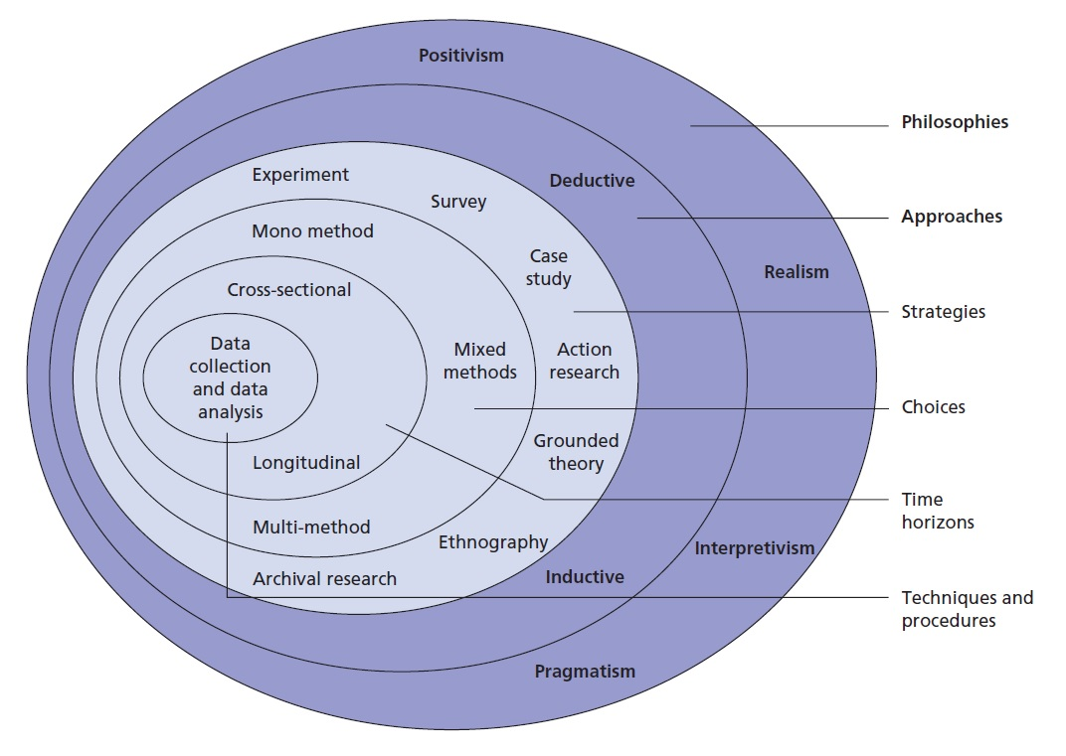
Building a disaster-resilient energy sector within the United Arab Emirates
Introduction
Research Objectives
Conclusion
A higher demand for oil on the international market but it also poses additional risks to the Emirati sector (EIA, 2017).
40% of the fatal injuries occurred within the UAE energy industry. (Statistics Centre Abu Dhabi, 2013)
The UAE energy sector is oriented towards ensuing more profitability, effectiveness and sustainability.
To analyse the literature on existing practices pertaining to disaster management including their suitability within the energy industry.
To review the extent to which the energy infrastructure and industry in UAE is vulnerable to hazards.
To evaluate the barriers that influence the application of disaster management practices within energy facilities in UAE.
To identify the best approaches for building a strategic disaster management and mitigation plan that would help to manage and mitigate potential future disasters in the UAE.
The energy sector is doing well in accommodating to the risks emerging from natural disasters.
The resilience of the sector against dessert storms, extreme weather events, heat, earthquakes seem to be high
The UAE energy sector has learned a lot from the international experience and the best practices to mitigate the vulnerabilities that can emerge from the climate change.
My findings are still not complete and In the future I will plan to gather more interview from other companies to compare my result.
This study will identify the vulnerabilities and the risks of the UAE energy sectors and propose practical and sustainable methods for addressing or minimising them.
Research problem
To comprehend what the UAE energy sector needs to build resilience it is important to understand the risks that the country faces
Possible hazards:
Natural: Earthquakes Tsunamis Climate change (tropical storms, water cycle disruptions, etc)
Man-made: Accidents Terrorism Cyber security
Research Methods
Literature review
Hazards, vulnerability and resilience are indeed interconnected, and that a deeper understanding of these issues would enhance resilience in critical infrastructure after a disaster.
Findings from the identifying and assessing risks, these risks need to be treated based on their urgency and impact. Solutions need to be identified and implemented, and furthermore, these processes need and should be continuously monitored and evaluated for efficiency.
References
Abel, A., Parfomak, P.W., and Shea, D.A. (2004) Electric Utility Infrastructure Vulnerabilities: Transformers, Towers, and Terrorism. CRS Report for Congress. Congressional Research Service
Rehak, D., Senovsky, P., and Slivkova, S. (2018) ‘Resilience of Critical Infrastructure Elements and Its Main Factors’. Systems 6 (2), 21 Robertson, K., Black, J., Grand-Clement, S., and Hall, A. (2016) Human and Organisational Factors in Major Accident Prevention: A Snapshot of the Academic Landscape [online] RAND Corporation. Saunders, M.N.K., Lewis, P., and Thornhill, A. (2009) Research Methods for Business Students. 5th ed. New York: Prentice Hall Schaeffer, R., Szklo, A.S., Pereira de Lucena, A.F., Moreira Cesar Borba, B.S., Pupo Nogueira, L.P., Fleming, F.P., Troccoli, A., Harrison, M., and Boulahya, M.S. (2012) ‘Energy Sector Vulnerability to Climate Change: A Review’. Energy 38 (1), 1–12 UNISDR (2009) UNISDR Terminology on Disaster Risk Reduction. Geneva, Switzerland: United Nations International Strategy for Disaster Reduction Walker, B., Holling, C.S., Carpenter, S., and Kinzig, A. (2004) ‘Resilience, Adaptability and Transformability in Social–Ecological Systems’. Ecology and Society [online] 9 (2). Zhou, H., Wang, J., Wan, J., and Jia, H. (2010) ‘Resilience to Natural Hazards: A Geographic Perspective’. Natural Hazards 53 (1), 21–41
Mitchell, T., and Harris, K. (2012) ‘Resilience: A Risk Management Approach’. Overseas Development Institute 111, 1-7
Niglia, A. (2016) Critical Infrastructure Protection Against Hybrid Warfare Security Related. Amsterdam: IOS Press
Schaeffer, R., Szklo, A.S., Pereira de Lucena, A.F., Moreira Cesar Borba, B.S., Pupo Nogueira, L.P., Fleming, F.P., Troccoli, A., Harrison, M., and Boulahya, M.S. (2012) ‘Energy Sector Vulnerability to Climate Change: A Review’. EneMitchell, T., and Harris, K. (2012) ‘Resilience: A Risk Management Approach’. Overseas Development Institute 111, 1-7
Niglia, A. (2016) Critical Infrastructure Protection Against Hybrid Warfare Security Related. Amsterdam: IOS Press
Schaeffer, R., Szklo, A.S., Pereira de Lucena, A.F., Moreira Cesar Borba, B.S., Pupo Nogueira, L.P., Fleming, F.P., Troccoli, A., Harrison, M., and Boulahya, M.S. (2012) ‘Energy Sector Vulnerability to Climate Change: A Review’. Energy 38 (1), 1–12
rgy 38 (1), 1–12
Qualitative, semi-structured interviews with 20 participants.
6 interviews done at the present moment.
Inclusion criteria: minimum 8 years of experience in the UAE energy sector.
Main source of primary data at the moment: ADNOC

