Slide 1
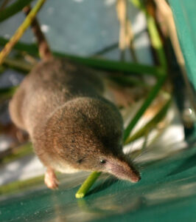
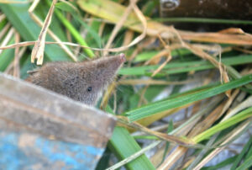
The invasion of the greater white-toothed shrew, and the potential disruption of the relationship between parasites and the native pygmy shrew in Ireland
Introduction
The invasion of the greater white-toothed shrew
Previously, the pygmy shrew (Sorex minutus) was the only shrew found in Ireland, until 2007 where animal pellets revealed the presence of the greater white-toothed shrew (Crocidura russula.)
The greater white toothed shrew (Figure 2) is approximately three times larger than the pygmy shrew (Figure 1), which can cause interspecific competition.
Ella Cooper, Dr. Kevin Bown, Dr. Allan McDevitt
School of Science, Engineering and Environment
Research Methodology
Expected Results and Conclusions
Previous sampling and lab protocols
Samples were collected over two
seasonal periods in late 2017 and
early 2018 across the south of Ireland.
Shrews were sampled from eastern,
western and southern transects,
where the sites were sectioned
into three invasion-stage zones:
before, during and after (Figure 3.)
A total of 124 greater white-toothed
shrews and 99 pygmy shrews were
collected from Ireland. Additionally,
40 of each shrew species were
collected from Belle Île.
Organs were harvested from the collected specimens and the DNA
from the gut content was extracted.
Further lab protocols and analysis
Of the original 223 samples from Ireland, 143 heart and 49 blood samples were available for this study.
The DNA from these samples will be extracted and further analyses (including PCR) will follow to detect the presence of blood parasites, such as Babesia spp. and Bartonella.
All 303 gut DNA samples, from Ireland and Belle Île, are also available, allowing the identification of gut parasites through metabarcoding.
The obtained results will show which individuals are infected with certain blood and/ or gut parasites, and further analysis will be able to determine:
Which factors play a significant role to an individuals likelihood of being infected, for example if they inhabit an “edge” zone.
The underlying mechanisms of the observed results
This will provide complementary data on how the greater white-toothed shrew has affected, and potentially become detrimental to, the pygmy shrew population in Ireland.
This is valuable information when designing appropriate conservation measures.
Figure 1. Pygmy shrew (Source: Sam Browett, 2021.)
Figure 2. Greater white-toothed shrew (Source: Sam Browett, 2021.)
The range in which the greater white-toothed shrew resides is expanding at an alarming rate, which is concerning due to the two species being unable to coexist in Ireland.
Parasites
Alongside habitat restraints, invasive species can effect native host-parasite interactions, in either amplification or dilution effects, depending on whether the invader can act as a competent reservoir host.
Figure 3. Sampling sites across the three transects, indicating the different invasion stages (“Before”, “During”, and “After”) in Ireland as well as the “Control” in Belle Île. The presence of S. minutus (orange) and C. russula (green) are also displayed (Source: Sam Browett et al., 2022.)
References
Browett, S., Synnott, R., O’Meara, D., Antwis, R., Browett, S., Bown, K., Wangensteen, O., Dawson, D., Searle, J., Yearsley, J. and McDevitt, A., 2022. Resource competition drives an invasion-replacement event among shrew species on an island.
Kelly, D., Paterson, R., Townsend, C., Poulin, R. and Tompkins, D., 2009. Has the introduction of brown trout altered disease patterns in native New Zealand fish?. Freshwater Biology, 54(9), pp.1805-1818. doi: 10.1111/j.1365-2427.2009.02228.x
McDevitt, A., 2013. Invasions and Expansions: the greater white-toothed shrew in Ireland. Genetics society news, [online] (68), pp.51-52. Available at: <https://genetics.org.uk/wp-content/uploads/2017/09/Issue-68-V2.pdf> [Accessed 22 May 2022]
Telfer, S. and Bown, K., 2012. The effects of invasion on parasite dynamics and communities. Functional Ecology, 26(6), pp.1288-1299. doi: 10.1111/j.1365-2435.2012.02049.x
Tosh, D., Lusby, J., Montgomery, W. and O'Halloran, J., 2008. First record of greater white-toothed shrew Crocidura russula in Ireland. Mammal Review, 38(4), pp.321-326. doi: 10.1111/j.1365-2907.2008.00130.x
Objectives
To explore any potential disruption of the relationships between the pygmy shrew and their associated blood and gut parasites, as a result of the invasion.
To determine the underlying mechanisms that have caused the observed effects.

