Slide 1
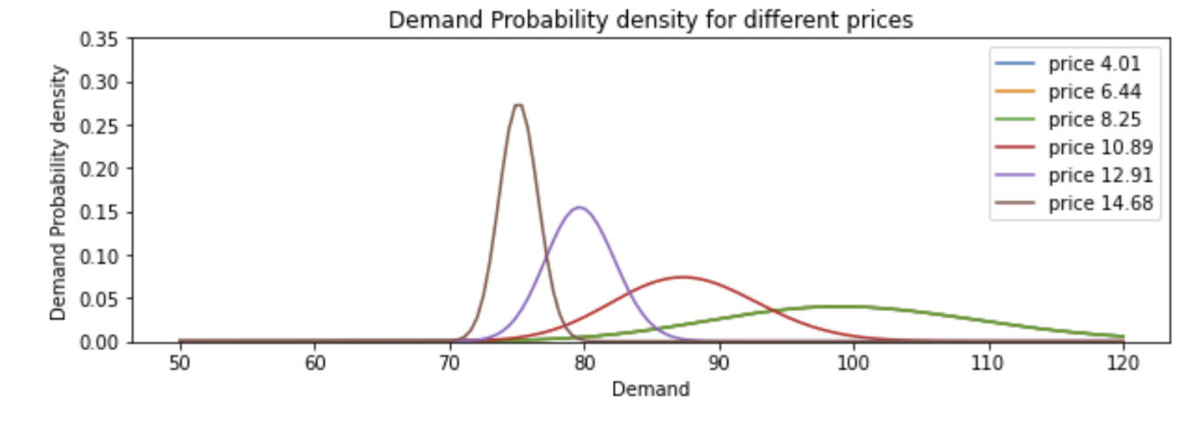


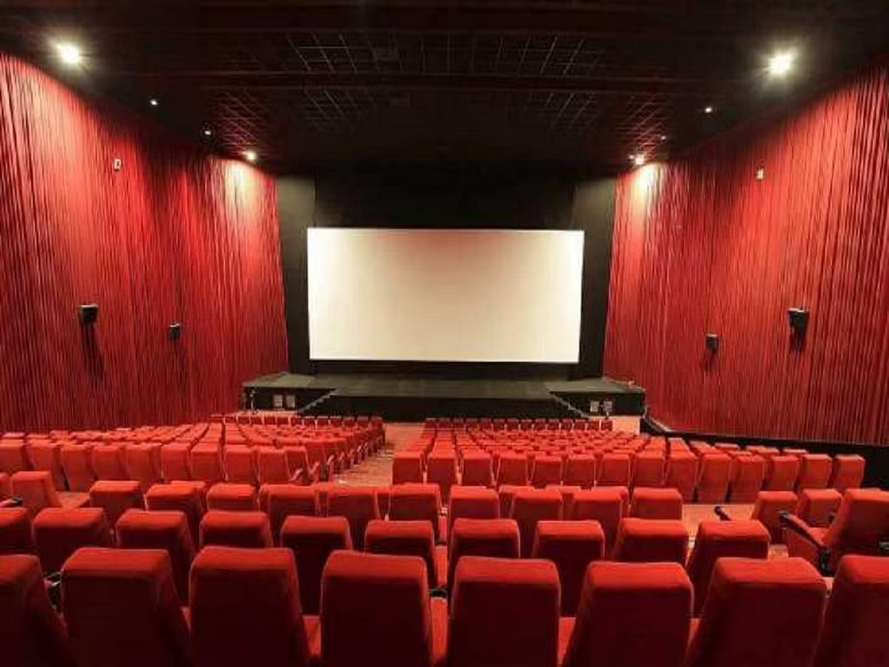

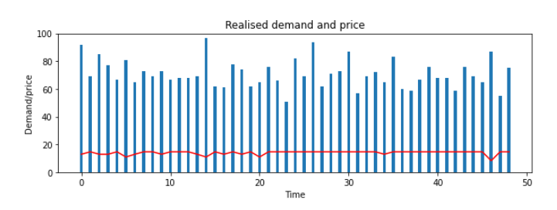
DATA MINING TECHNIQUES FOR DYNAMIC PRICING MODELS WITH FAIRNESS AND ETHICS
Lakshmi Lineshah(l.c.lineshah@edu.salford.ac.uk) and Prof Sunil Vadera (s.vadera@salford.ac.uk)
School of Science Engineering and Environment, University of Salford, M5 4WT .
Introduction
DATA ANALYSIS AND MODELLING
Research Direction
Dynamic pricing is a set of pricing methods designed for increasing profits. This is also well-known as revenue management or yield management . Dynamic pricing aims to solve the problem of how to maximise the revenue in long term by effectively estimating the demand and setting the price accordingly. Dynamic pricing can be used in different business applications such as e-commerce, airline ticketing, insurance, perishable products etc.
Developing a dynamic pricing model with a multi armed bandit algorithm that defines an optimal pricing strategy over different dynamic pricing problems and the thesis will investigate how changes in the market impact the optimal solution in different dynamic pricing problems and industry that use these algorithms.
Study how these models’ impact on different business applications and optimal expected profit considering the ethical and fairness of the model.
Establish an efficient and practical algorithm for computing the optimal prices. Furthermore, the proposed pricing model will be tested using a simulation environment to validate the effectiveness of the model.
Identify the best MAB algorithm that can be used in different dynamic pricing problem types.
Initially all price levels have the same demand parameters. The algorithm investigates different prices to calculate the best revenue. After a period, it becomes evident that the price £14.68 delivers the best revenue. And starts to choose this price more frequently but, at the same time alternative price options are also explored occasionally. This approach has an advantage of having a pricing policy described by the seller at certain set of price levels.
Contribution
A comprehensive survey of dynamic pricing identifying different problem types and strategies used in different business applications.
A comparison study of different methods for dynamic pricing and their applicability in different business problem types.
A dynamic pricing model using multi armed bandit algorithm that defines an optimal pricing strategy over different dynamic pricing problems. Study how these models’ impact on different business applications and optimal expected profit. The ethical and fairness impact is also considered.
Conclusion
Business can benefit from using a dynamic pricing model best suited for their use case.
Dynamic pricing using MAB and comparison studies which will be subjected to future research.
References
Velde, R. M. a. V. t., 2019. Dynamic Pricing in Airline Industry. s.l., California Institute of Technology. Boer, V. d., 2015. Dynamic Pricing and Learning. Historical origins, current research and new directions, Issue 20, pp. 1-18.

